Slide 1




Zeal Education Society’s ​
ZEAL COLLEGE OF ENGINEERING AND RESEARCH, ​
NARHE │PUNE - 41 │ INDIA ​
DEPARTMENT OF DATA SCIENCES ​
MINI PROJECT SEMINAR – I​​​
Identifying Real Exoplanets from a Telescope Generated Data using​​
Machine Learning​​​
Presented
by
Arbaaz Mohammad Shaikh
Under Guidance
of
Prof. G.C. Chandangole

Slide 2

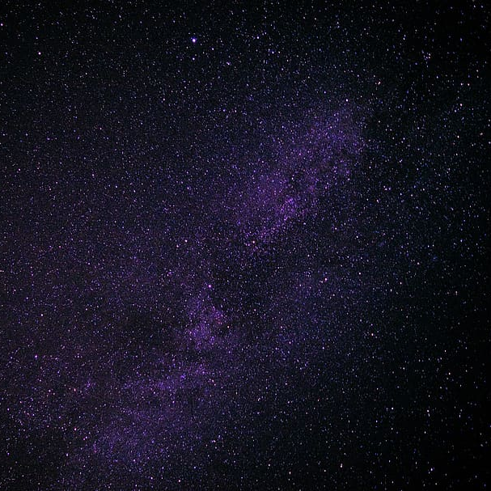
Abstract
Introduction
Objective/Motivation
Dataset And Features
Data Pre-Processing
Literature survey
Machine Learning Models
Results
Applications
Conclusion
Future Scope
Bibliography/References
AGENDA

Slide 3
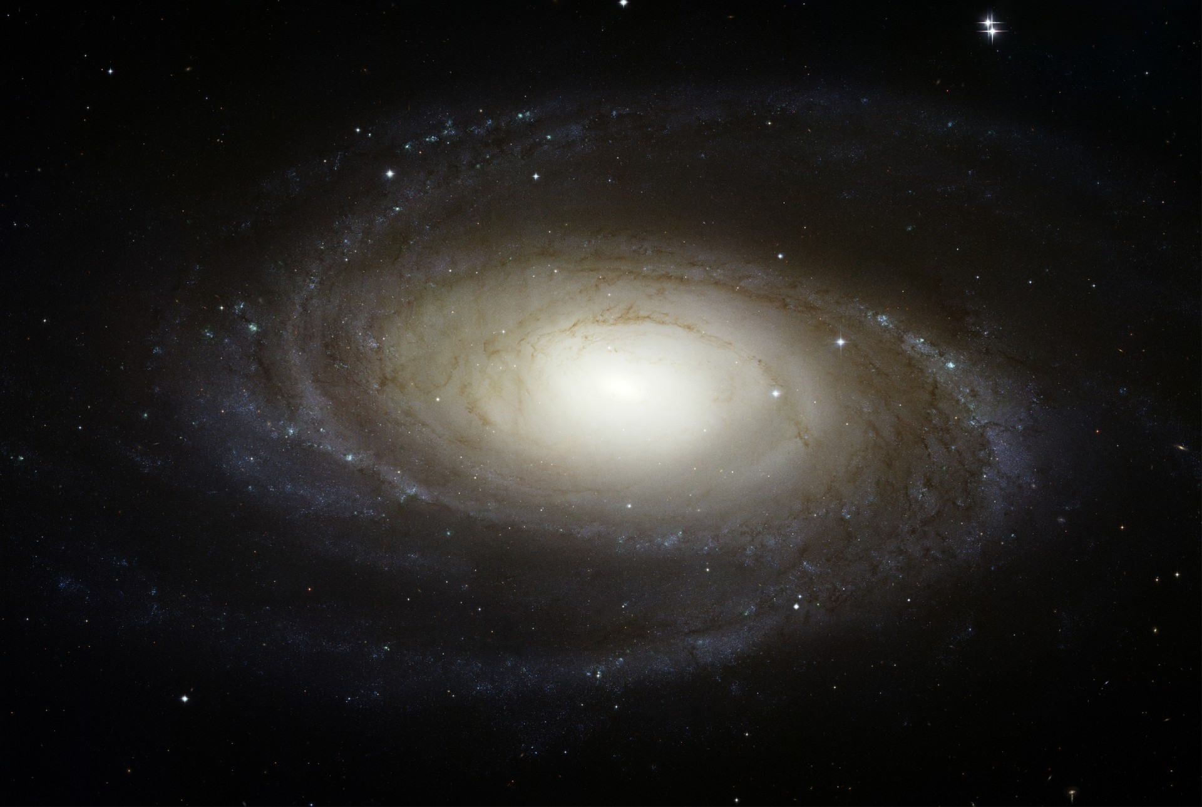
ABSTRACT
We are at unique era of human history where within next few years we may be able to confirm earth like planets or earth’s twin around other stars where conditions are suitable for life to exists or even find a proof of life on those planets. NASA launched Kepler space telescope in 2009 which looked at a patch of sky and studied over 150,000 stars and found around 2500 confirmed planets around other stars using transit method. Scientist and researchers have identified several of these planets which could be suitable for life based on planet and parent star's features. Purpose of this project is to use data generated from Kepler space telescope and produce machine learning model which could use planetary and stellar features to classify exoplanets into habitable and non-habitable planets.

Slide 4
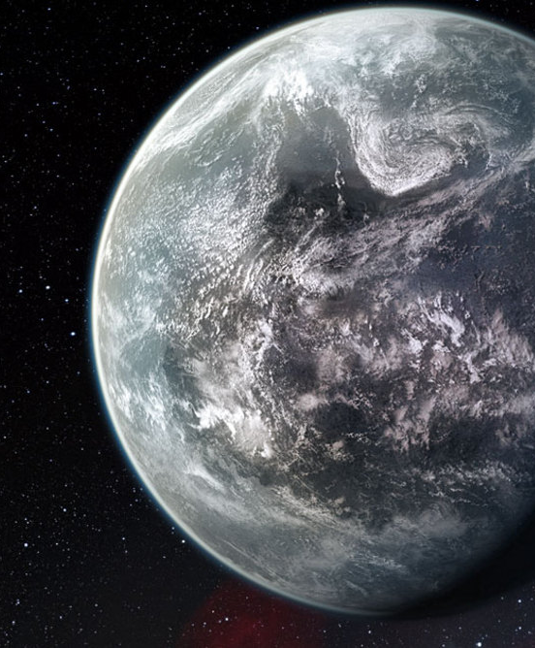
INTRODUCTION
What is an exoplanet? How do we find them? Most importantly, why do we want to find them? Exoplanets are planets outside of our Solar System they orbit any star other than our Sun. We can find these exoplanets via a few methods: radial velocity, transits, direct imaging, and microlensing. NASA's Kepler mission proved to be a major milestone in the journey of finding the planets far away from our solar system. These planets discovered outside our solar system are termed to be Exoplanets. The curiosity of the people to know about any other habitation in the distant world have led to rapid research in a bid to identify habitable exoplanets. As of July 2021, astronomers have discovered 4400 conﬁrmed planets and a majority of those are detected by the Machine Learning Techniques. This project’s goal is to take the data generated by Kepler Telescope as training data and use Planetary features to build a machine learning model which could predict potentially real exoplanet. Output of this project is to build machine learning model and predict real exoplanets from Kepler database.

Slide 5


OBJECTIVE / MOTIVATION
Until just a few years ago, astronomers had only confirmed the presence of fewer than a thousand exoplanets. Then came the Kepler mission, and the number of exoplanets exploded. The Kepler mission has taken its place and found new exoplanets in the night sky. It is monitoring the brightness of stars for periodic drops caused by planet transits. The Kepler mission is finding planets ranging from small, rocky worlds to giant planets, showcasing the diversity of planets in the galaxy.
I wanted to see if I could look at the available exoplanet data and make predictions about which planets might be real candidate for exoplanet. The data made publicly available by NASA is beautiful in that it contains many useful features. The objective is to create a model that can predict the existence of a real Exoplanet, utilizing the readings collected by the Kepler's Telescope from different stars over time.

Slide 6
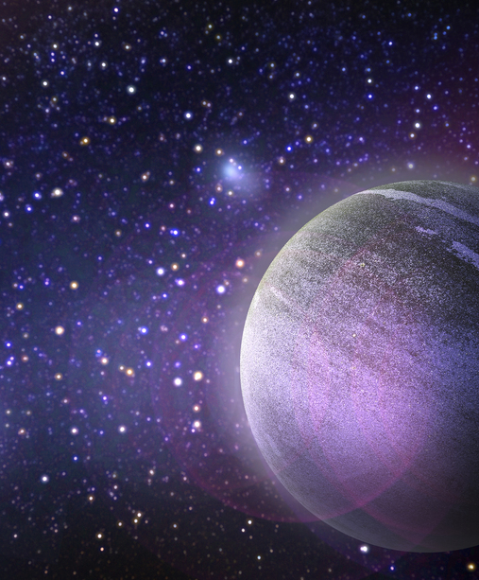
DATASET & FEATURES
I have 9,564 observations and 49 features. The features have some very technical names. Thus, I renamed the columns for more meaningful names. Now, let’s understand what data we have, We can take a look at the DataFrame and use Exploratory Data Analysis method. I identify a few categorical features that I will be going to work on .
I have choosen the targets I want to predict: Exoplanet Archive Disposition and Disposition Using Kepler Data. Since I am focusing on data collected by the Kepler mission, So I used second option. We also need a continuous target. So, I transform target variable into a binary feature using lambda.
Since there is no explicit list of non-habitable planets, an assumption was made that all “confirmed” Kepler planets are habitable and thus after removing habitable planets from “confirmed” planet list, whatever remained in “confirmed” planet list must be potentially non-habitable planet.

Slide 7
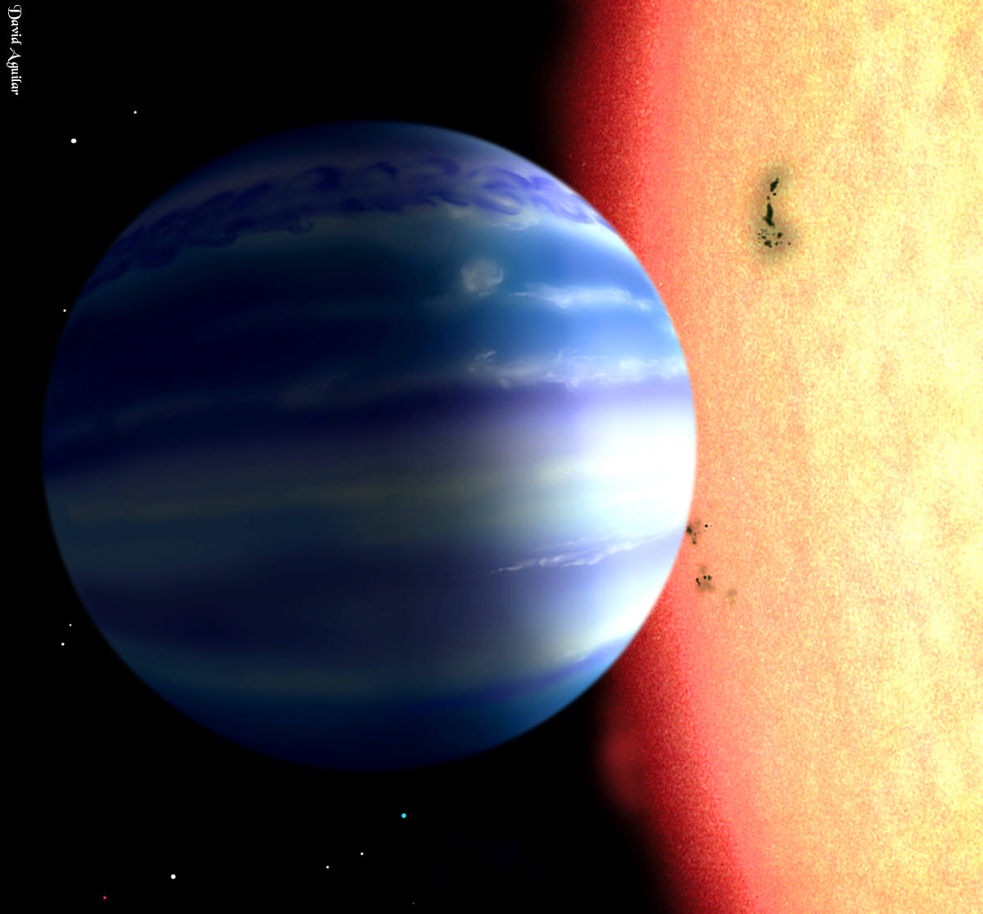
DATASET PRE-PROCESSING
Each record of Kepler data was identified by a unique id called 'KOI' (Kepler Object of Interest). Each record contained 50+ attributes about observation. There were several categories of attributes such as "exoplanet archive information" or "threshold crossing event" or other optical attributes which were not directly related with planet’s habitability. For habitability analysis we were interested only in planetary and stellar features. After analyzing each attribute of Kepler data from its description 39 planetary and stellar features were identified. Some of these features are "Planetary Radius", "Isolation Flux", "Equilibrium Temperature", "Orbital Period", "Distance from parent Star", "Stellar Temperature" etc. Since habitable planets are less, planets with both "confirmed" and "candidate" disposition are selected. Reason behind this was, even if "candidate" planet ultimately turned out to be "false positive", still its features would be a valid data point for our purpose. For non-habitable planets, we selected planets with only "confirmed" disposition.

Slide 8

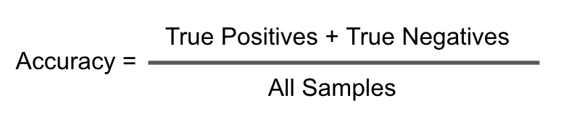
LITERATURE SURVEY
EVALUATION METRICS- Evaluation metrics are used to measure the quality of the machine learning model. Evaluating machine learning models is essential for any project. Here I have evaluated my machine learning algorithms to find how my models work with my dataset. Evaluation metrics plays a major role as it give an overall idea for my entire project how well it is performing. There are many different types of evaluation metrics available to test a model. Some of which I have applied to my machine learning models are as follows-
ACCURACY- It is defined as the percentage of correct predictions for the test data. It can be calculated easily by dividing the number of correct predictions by the number of total predictions.

Slide 9

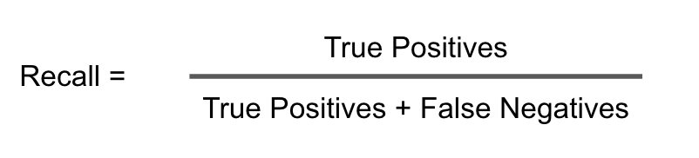
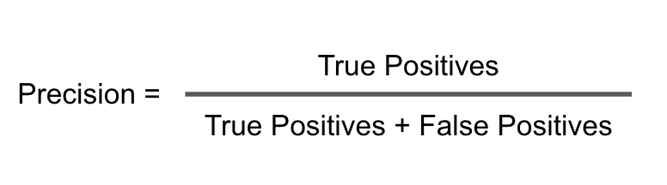
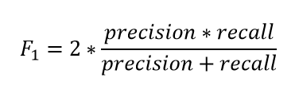
RECALL- It is defined as the fraction of examples which were predicted to belong to a class with respect to all of the examples that truly belong in the class.
PRECISION- It is defined as the fraction of relevant examples (true positives) among all of the examples which were predicted to belong in a certain class.
F1 SCORE- The F1-score is a way of combining the precision and recall of the model, and it is defined as the harmonic mean of the model’s precision and recall.

Slide 10

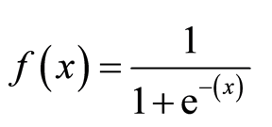
MACHINE LEARNING MODELS
Before going to the models, we should create a train and test set using Sklearn. We will assign 60% of the dataset to the train set and 40% to the test set.
X_train, X_test, y_train, y_test = train_test_split(features, target, random_state=1, test_size=.40)
MODELS -
LOGISTIC REGRESSION -
Logistic Regression is a popular statistical model used for binary classification, that is for predictions of the type this or that, yes or no, A or B, etc. Here we will focus on classifying the confirmed exoplanets. It is one of the most frequently used machine learning algorithm

Slide 11
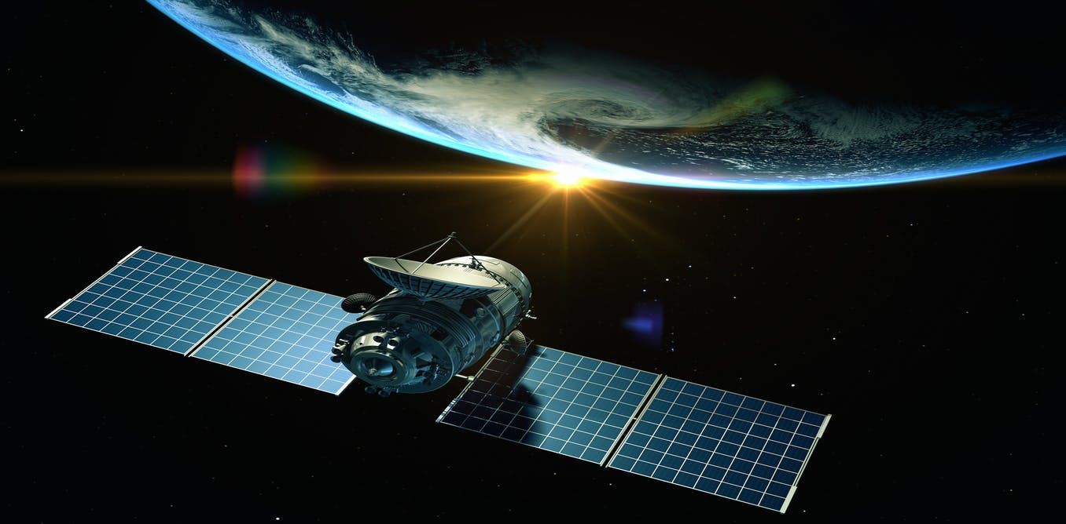
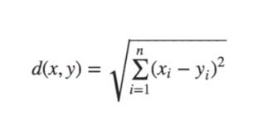
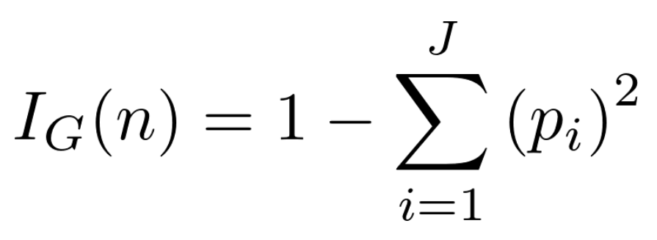
K-NEAREST NEIGHBORS
KNN can be used for both classification and regression predictive problems. However, it is more widely used in classification problems in the industry. In my project it helps to find the nearest features and do complex mathematics and produces best results to detect real exoplanet.
DECISION TREE
Decision Tree is a Supervised learning technique that can be used for both classification and Regression problems, but mostly it is preferred for solving Classification problems. It is a tree-structured classifier, where internal nodes represent the features of a dataset, branches represent the decision rules, and each leaf node represents the outcome. Simmilarly in my project it works with the internal features and give accurate results

Slide 12
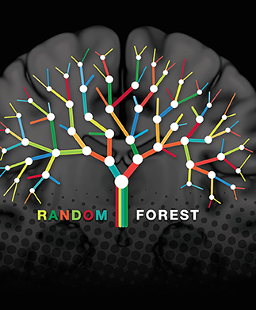

RANDOM FOREST
Random forest is a supervised learning algorithm. The "forest" it builds, is an ensemble of decision trees, usually trained with the “bagging” method. The general idea of the bagging method is that a combination of learning models increases the overall result. The final prediction is done by taking a vote from all n trees. Here in my project the model worked very well and had the best accuracy among all the other algorithms.

Slide 13

RESULTS
LOGISTIC REGRESSION RESULTS-
Evaluation Metrics: Accuracy: 0.8193465727098014 Recall: 0.85995085995086 F1 Score: 0.8323424494649226 Precision: 0.8064516129032258 Confusion Matrix: TN, FP, FN, TP [1158 336 228 1400]
K-NEAREST KNEIGHBORS RESULTS-
Evaluation Metrics: Accuracy: 0.8014093529788597 Recall: 0.8415233415233415 F1 Score: 0.8154761904761906 Precision: 0.7909930715935335 Confusion Matrix: TN, FP, FN, TP [1132 362 258 1370]

Slide 14
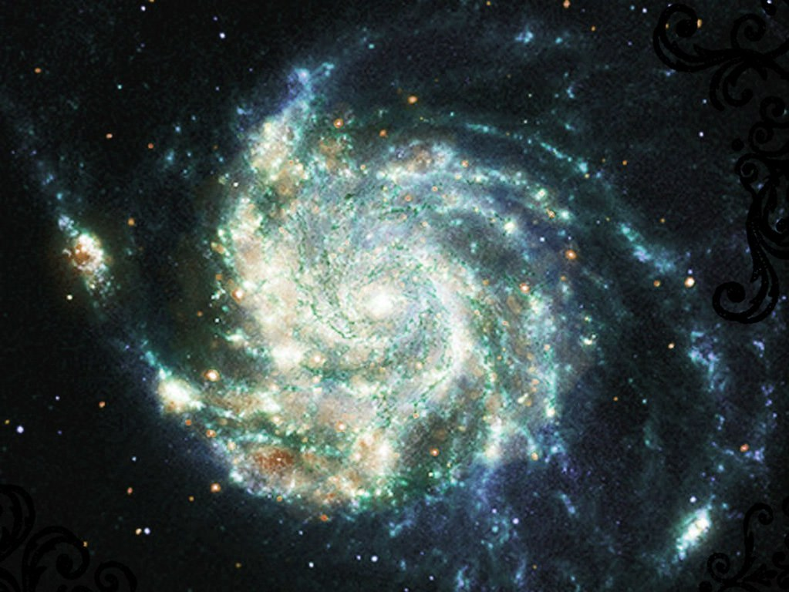
RESULTS
DECISION TREE RESULTS-
Evaluation Metrics: Accuracy: 0.9336963484945547
Recall: 0.9385749385749386 F1 Score: 0.9365614465216059
Precision: 0.9345565749235474
Confusion Matrix: TN, FP, FN, TP [1387 107 100 1528]
RANDOM FOREST RESULTS-
Evaluation Metrics: Accuracy: 0.9606021780909674 Recall: 0.9465601965601965
F1 Score: 0.9616224648985959 Precision: 0.9771718452758402 Confusion Matrix: TN, FP, FN, TP [1458 36 87 1541]

Slide 15
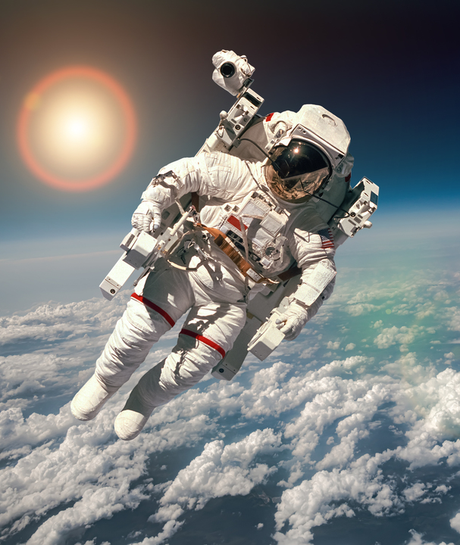
APPLICATIONS OF MACHINE LEARNING IN SPACE EXPLORATION-
1. First Image of Black Hole
2. AI-Based Assistants and Robots
3. Intelligent Navigation System
4. Discovery of Kepler Exoplanets
5. Space Debris Solution

Slide 16
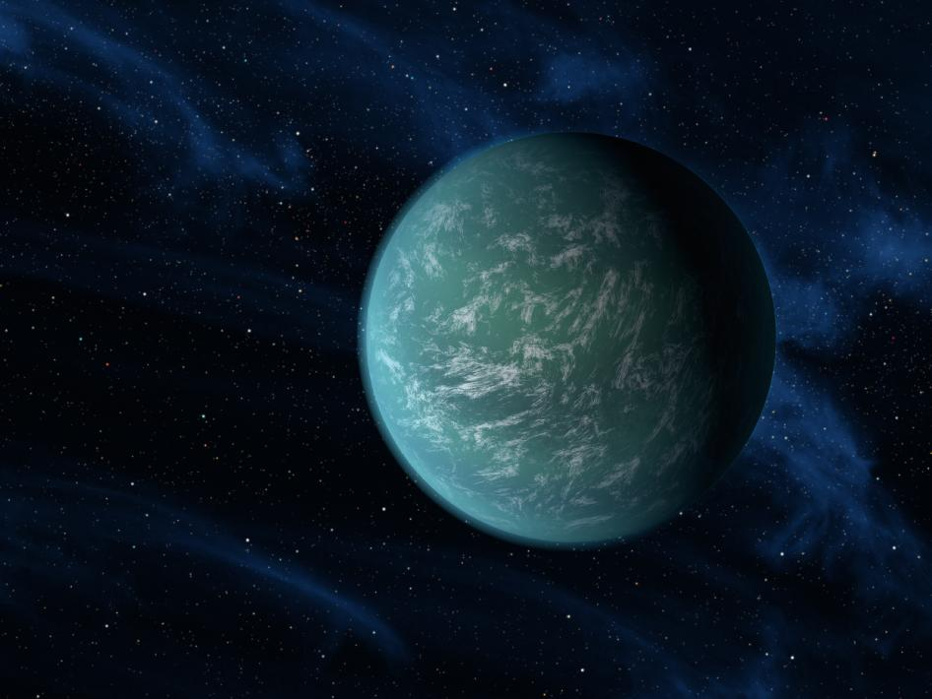
CONCLUSION
My machine learning model is successfully working by using data from Kepler mission and it also predicted real exoplanets with characteristic that we expect from habitable planets. Random Forest turned out to be a good machine learning model for this project. I was able to predict with a 96% accuracy whether our observations is an exoplanet or not. For a model that is quite complex to set up I was able to accomplish my goal.

Slide 17
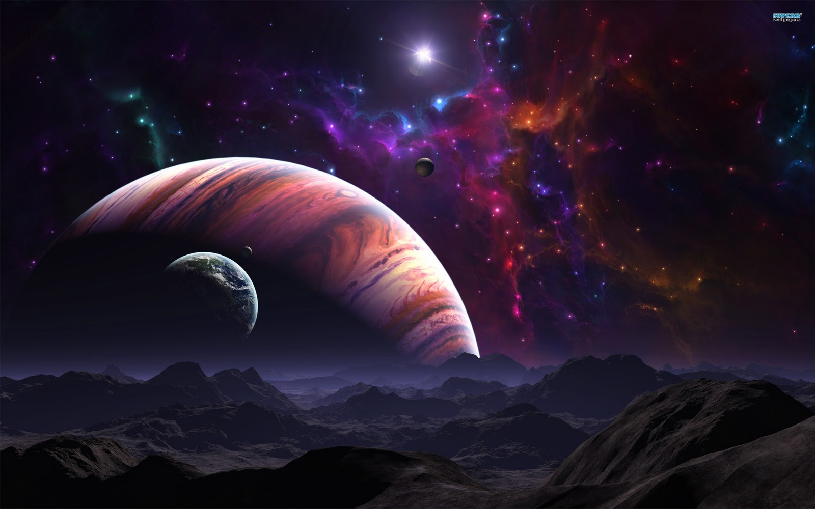
FUTURE SCOPE
New similar missions to study exoplanets such as TESS (Transit Exoplanet Search Satellite), JWST (James Webb Space Telescope), WFIRST (Wide Field InfraRed Survey Telescope) are on the way. There would be an explosion of exoplanets data in future. Machine learning would greatly help us in accumulating the existing knowledge about habitability through machine learning model and applying it on new data to quickly narrow down the habitable planet's list.
Deep learning model will also become more accurate as and when more training data about real exoplanets from new sources become available.
As, more and more data gets available in due course of time the classification models would evolve with it accordingly.
There is so much to explore in the space and with the new missions to be launched we can explore and help the humanity to explore new worlds in the space with the skill of Data Science.

Slide 18

BIBLIOGRAPHY/REFERENCES
[1] Geoffrey W. Marcya,1, Lauren M. Weissa, Erik A. Petiguraa, Howard Isaacsona, Andrew W. Howardb, and Lars A. Buchhavec Occurrence and core-envelope structure of 1–4× Earth-size planets around Sun-like stars 2013 http://www.pnas.org/content/111/35/12655.full
[2] NASA Kepler mission https://www.nasa.gov/mission_pages/kepler/overview/index.html
[3] NASA exoplanet archive https://exoplanetarchive.ipac.caltech.edu/docs/data.html
[4] Planetary Habitability Laboratory "http://phl.upr.edu/projects/habitable-exoplanets-catalog/data"
[5] Susan E. Thompson et. al. “PLANETARY CANDIDATES OBSERVED BY Kepler. III 2017 https://arxiv.org/pdf/1710.06758.pdf
[6] Python program that build machine learning model and predict habitability "https://github.com/rkmisra/cs229_project/blob/master/src/predict_habitability.py"
[7] NASA cumulative data https://exoplanetarchive.ipac.caltech.edu/cgi-bin/TblView/nph-tblView? app=ExoTbls&config=cumulative
[8] Habitable planets list "https://github.com/rkmisra/cs229_project/blob/master/data/habitable_planets_detailed_list.csv"
[9] Non habitable planets list "https://github.com/rkmisra/cs229_project/blob/master/data/non_habitable_planets_confirmed_detailed _list.csv"
[10] NASA Kepler data column definition "https://exoplanetarchive.ipac.caltech.edu/docs/API_kepcandidate_columns.html"

